Slide 1
A Project Presentation on
DISEASE PREDICTION USING MACHINE LEARNING ALGORITHMS
Challa Preetham Reddy 700745109
Bommareddy Eshwar Reddy 700748146
Kurapati Rushikeshkumar 700754809

Slide 2
CONTENTS
INTRODUCTION
OBJECTIVES AND OUTCOMES
REQUIREMENTS
IMPLEMENTATION
RESULTS
REFERENCES

Slide 3
INTRODUCTION
In today’s world number of patients are far greater than the number of doctors.
So it is difficult for doctors to go through every patient data and identify their disease.
Advancement of AI and ML made this easier.
So, we have come up with a project “Disease prediction using machine learning algorithms” which helps us to get most precise results based on the given symptoms.
This will be helpful for taking necessary actions for the diseases at an early stage.

Slide 4
OBJECTIVES
The main objective of this project is to predict diseases by giving symptoms as input.
OUTCOMES
Developing a GUI application where the disease is predicted by the given symptoms.

Slide 5
REQUIREMENTS
HARDWARE :
RAM: 4GB
HDD: 40GB min
PROCESSOR: i5 or above
OS: WINDOWS 10
LANGUAGE USED:
PYTHON 3.8.5

Slide 6
IMPLEMENTATION
Ensemble Learning
Symptoms
Algorithms
Outcome

Slide 7

DECISION TREE
It is a tree-structured classifier, where internal nodes represent the features of a dataset, branches represent the decision rules and each leaf node represents the outcome.
In a Decision tree, we have Decision Node and Leaf Node.
Decision nodes are used to make any decision and have multiple branches, whereas Leaf nodes are the output of those decisions.
A decision tree simply asks a question, and based on the answer (Yes/No), it further split the tree into subtrees.
It is a graphical representation for getting all the possible solutions to a problem/decision based on given conditions.

Slide 8
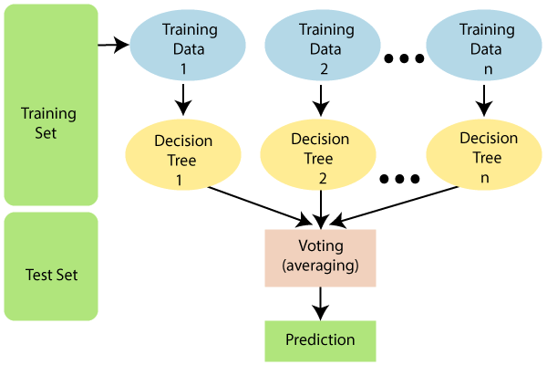
RANDOM FOREST CLASSIFIER
Random forest is a classifier that contains a number of decision trees on various subsets of given dataset and takes average to improve accuracy of dataset.
Instead of relying on one decision tree, the random forest takes prediction from each tree and based on majority votes of predictions it predicts final output.
The greatest number of trees in the forest leads to higher accuracy.
It is based on concept of ensemble learning.

Slide 9
NAÏVE BAYES:
Naïve Bayes Classifier based on Bayes’ Theorem. It is a probabilistic classifier, which means it predicts on the basis of the probability of an object.
It is not a single algorithm but a family of algorithms where all of them share a common principle, i.e. every pair of features being classified is independent of each other.
Gaussian Naive Bayes is a variant of Naive Bayes that follows Gaussian normal distribution and supports continuous data.
Gaussian distribution is a probability distribution that is symmetric about the mean, showing that data near the mean are more frequent in occurrence than data far from the mean.
Gaussian Naïve Bayes is used when we assume all the continuous variables associated with each feature to be distributed according to Gaussian Distribution.

Slide 10
SUPPORT VECTOR MACHINE:
Support Vector Machine or SVM, is a popular supervised learning algorithm
The main goal of SVM algorithm is to find best line or decision boundary for categorizing n-dimensional space into classes so that new data points can be placed easily.
ENSEMBLE LEARNING:
Ensemble learning is a process in which multiple models are combined to give a single output.
This process is mainly used to increase the performance.
There are many methods in ensemble learning some of the simple ensemble techniques are Max voting, Averaging and Weighted Average

Slide 11
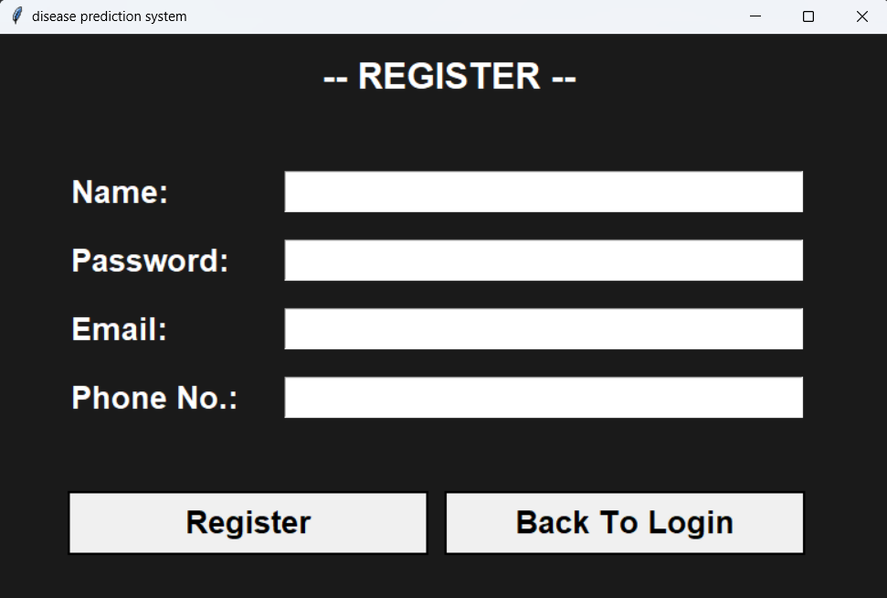
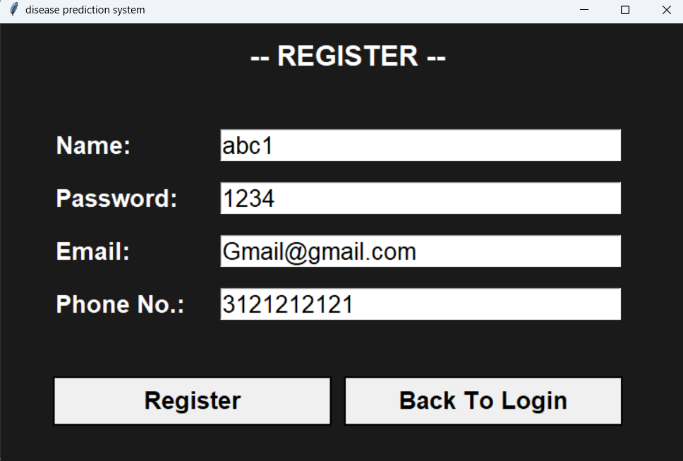
Results

Slide 12
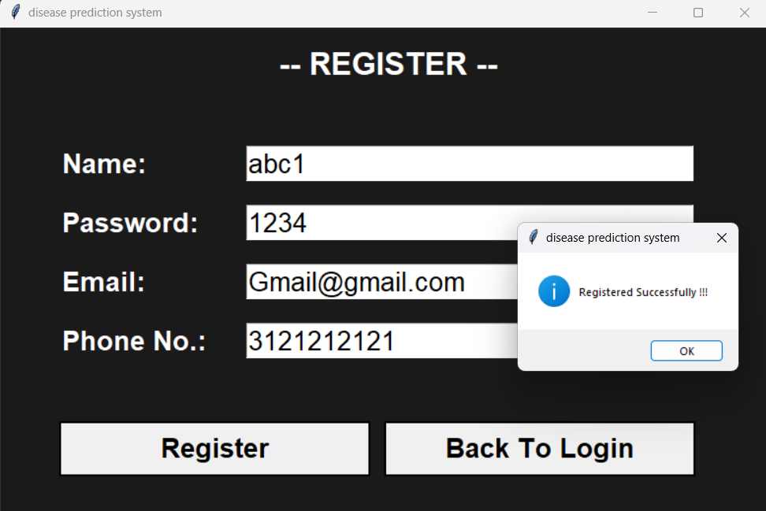
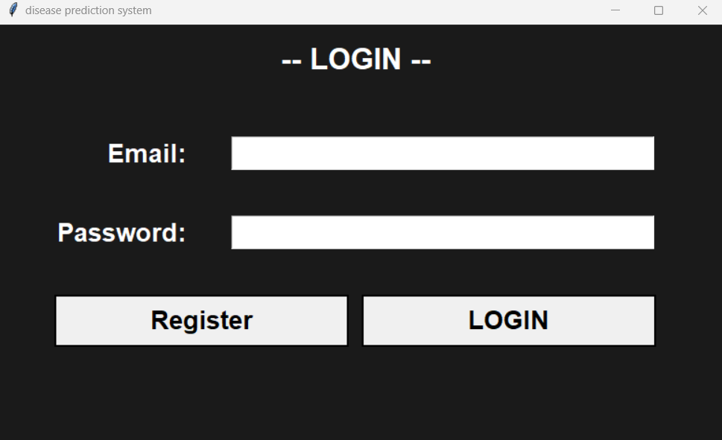

Slide 13

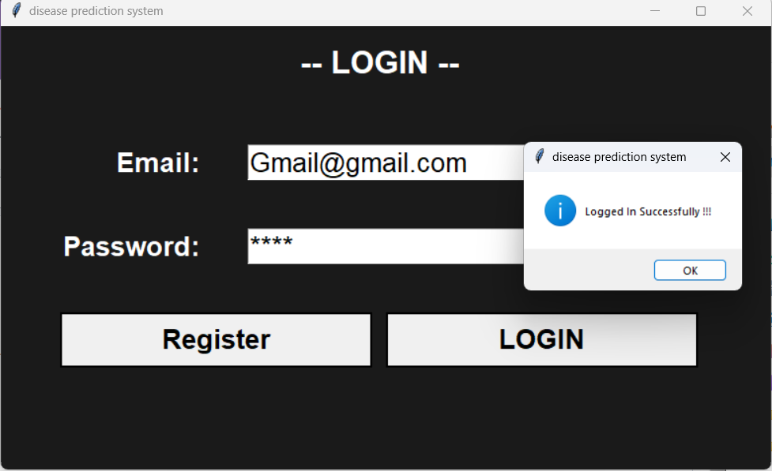

Slide 14

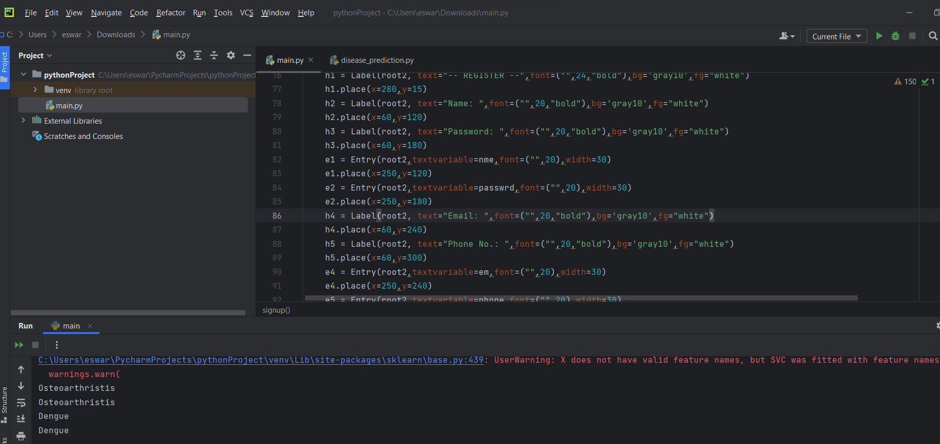
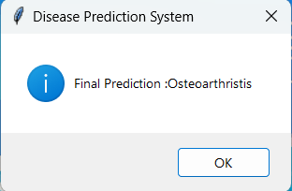

Slide 15
REFERENCES
https://ieeexplore.ieee.org/document/9154130
https://www.researchgate.net/publication/347381005_Disease_Prediction_Using_Machine_Learning
https://bmcmedinformdecismak.biomedcentral.com/articles/10.1186/s12911-019-1004-8

Slide 16
THANK YOU

